Slide 1




TACTICAL COMBAT CASUALTY CARE COURSE
MODULE 19: FRACTURES
Module 19: Fractures
#TCCC-CPP-PPT-19 08 AUG 23
COMBAT PARAMEDIC/ PROVIDER
TCCC TIER 1
All Service Members
TCCC TIER 2
Combat Lifesaver
TCCC TIER 3
Combat Medic/Corpsman
TCCC TIER 4
Combat Paramedic/Provider

Slide 2




Module 19: Fractures
TACTICAL COMBAT CASUALTY CARE (TCCC) ROLE-BASED TRAINING SPECTRUM
ROLE 1 CARE
NONMEDICAL PERSONNEL
MEDICAL PERSONNEL
YOU ARE HERE
STANDARDIZED JOINT CURRICULUM
#TCCC-CPP-PPT-19 08 AUG 23
2
Notes:
This module discusses the management of fractures in the Tactical Field Care (TFC) setting, highlighting your role as a Combat Paramedic or Provider (CPP).
All Service Member and Combat Lifesaver training educates non-medical personnel about basic splinting principles and Combat Medic/Corpsman training teaches additional techniques for applying different splints. As a Combat Paramedic/Provider you also need to understand how guidance was developed and be able to answer questions about the principles of fracture management in a TFC environment.

Slide 3





Module 19: Fractures
1 x TERMINAL LEARNING OBJECTIVES
Given a combat or noncombat scenario, perform assessment and initial treatment of fractures during Tactical Field Care in accordance with CoTCCC Guidelines.
  Identify signs of a suspected fracture.
  Describe the principles of basic care and fracture management IAW CoTCCC Guidelines.
  Demonstrate proper splint application using a malleable, rigid, or improvised splint to a suspected fracture in Tactical Field Care.
  Identify any evidence-based medicine, best practices, casualty data, and Subject Matter Expert consensus on fracture management techniques in Tactical Field Care.
04 x ENABLING LEARNING OBJECTIVES
#
= Terminal Learning Objectives
= Cognitive ELOs
= Performance ELOs
#TCCC-CPP-PPT-19 08 AUG 23
3
Notes:
There are three cognitive and one performance-enabling learning objectives in this module to support the TCCC Guideline section on splinting that states “splint fractures and recheck pulses.”
You will learn how to identify the signs of a suspected fracture and distinguish between fracture types.
Afterward, you will demonstrate the basic care for fractures, including the application of malleable and improvised rigid splints. And, depending on the unit mission, you may also receive additional fracture management training and be asked to demonstrate additional splinting techniques.
Additionally, you will learn about the evidence supporting fracture management techniques in Tactical Field Care.

Slide 4
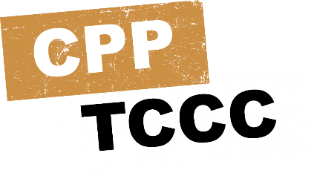

Module 19: Fractures
SPLINTING TFC OVERVIEW
Video can be found on deployedmedicine.com
Notes:
The following video provides an overview of the principles of splinting and fracture care that take place in Tactical Field Care.

Slide 5
MARCH PAWS
Module 19: Fractures
LIFE-THREATENING
AFTER LIFE-THREATENING
PAIN ANTIBIOTICS
WOUNDS SPLINTING
M A R C H
P A W S
MASSIVE BLEEDING
#1 Priority
AIRWAY
RESPIRATION (Breathing)
CIRCULATION
HYPOTHERMIA / HEAD INJURIES
#TCCC-CPP-PPT-19 08 AUG 23
5
Notes:
Splinting fractures is the “S” in the MARCH PAWS sequence.

Slide 6

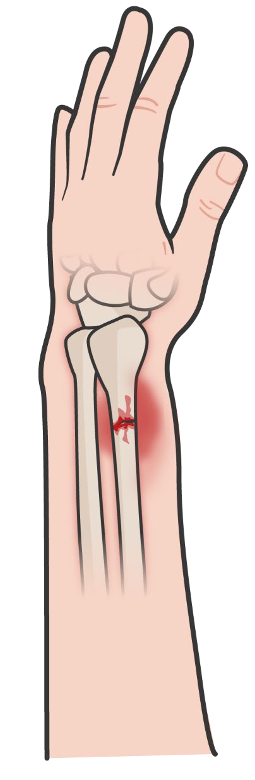
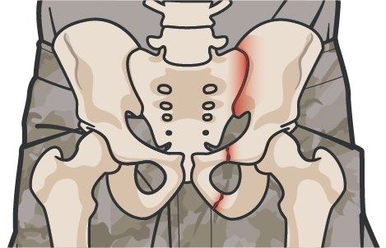


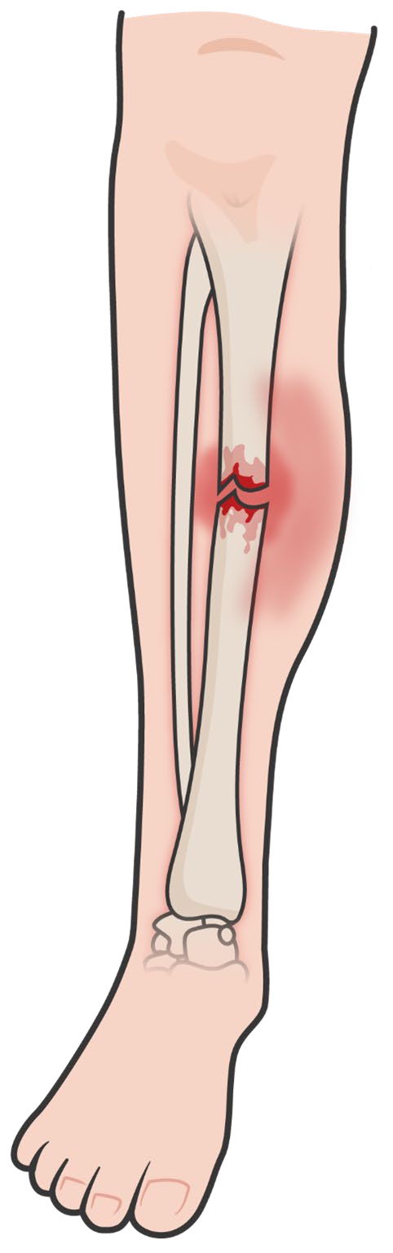

SIGNS OF A SUSPECTED CLOSED FRACTURE
Module 19: Fractures
Significant blood loss is possible when dealing with Femur Fractures:
Approximate Internal Blood Loss Associated with Fractures
Bone fractured | Internal blood loss *milliliters [ml] per fracture
Rib | 125ml
Radius or ulna | 250-500ml
Humerus | 500-700ml
Tibia or fibula | 500-1,000ml
Femur | 1,000-2,000ml
Pelvis | 1,000 - MASSIVE
CLOSED FRACTURE
No open wound (break in skin)
Risk for tissue damage still significant
Treat all fractures with nearby skin wounds as open fractures
P A W
S
#TCCC-CPP-PPT-19 08 AUG 23
6
Notes:
The majority of wounds sustained by soldiers in combat zone are to the extremities; largely due to the nature of modern body armor.^{1, 2} Fractures of the extremities or the rib cage are often more likely to be identified and are more easily diagnosed than fractures involving the pelvis or spine.
As discussed in the module on circulation, a pelvic compression device is indicated in any casualty who suffers severe blunt force or blast injury and has pelvic pain, a lower limb amputation or near amputation, physical findings suggestive of a pelvic fracture (for example, laceration or bruising at bony prominences of the pelvic ring, crepitus, a deformed or unstable pelvis, or unequal leg lengths), unconsciousness or shock.³
Spinal fractures often present with localized spinal pain, or pain radiating down the extremities from nerve irritation, and may include a deformity at the point of injury, a hematoma, or crepitus. In some cases, motor function can be affected leading to partial or complete paralysis, and sensation can be diminished or absent. Splints are not applied to spinal fractures, although the casualty may be immobilized, depending on the tactical situation. ⁴
Fractures of the extremities are a more common injury and share some of those same presenting signs. In the setting of trauma, localized pain and swelling should be treated as a suspected fracture, even if no other signs are present; although if the pain is significant enough to alter the casualty’s use of the extremity it may be fractured even when swelling is absent.⁵ Additionally, the presence of a hematoma or crepitus in the area of the injury, or a physical deformity of the bone (either under the skin or through an open wound) is sometimes present. Occasionally, the casualty or another responder will tell you that they actually heard a snap or crack when the bone fractured.
Keep in mind that many casualties have a high pain tolerance, and the adrenaline from a traumatic event may mask some of the signs for a period of time. So, maintain a low threshold for treating a painful or deformed bone as a potential fracture.
A pelvic compression device is indicated in any casualty who suffers severe blunt force or blast injury with symptoms of a pelvic fracture. Splints are not applied to spinal fractures, though the casualty may be immobilized, depending on the tactical situation.

Slide 7

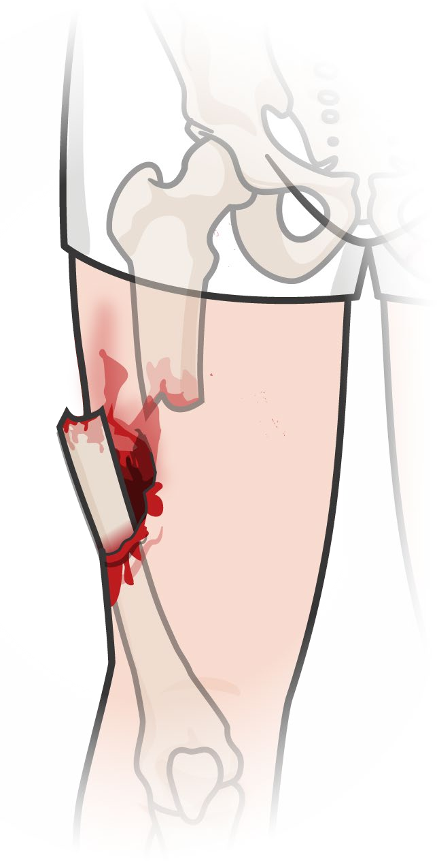
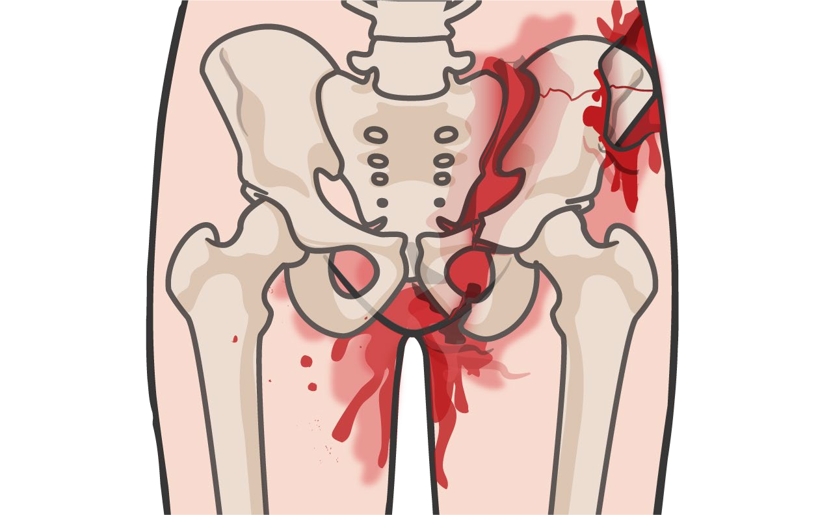
Module 19: Fractures
SIGNS OF AN OPEN FRACTURE
WARNING SIGNS OF AN OPEN FRACTURE:
Significant tenderness, pain and/or marked swelling
Bone protruding from the wound
Open wound near the site
Bleeding
Crepitus (crackling/popping under the skin)
Different length or shape of limb
Loss of pulse or sensation distally in the injured arm or leg
Open fracture to the pelvis may lacerate the rectum, perineum, or vagina, and an obvious source of external blood loss may not be readily apparent.
Every effort should be made to control bleeding coming from the site, before any splinting is attempted
P A W
S
#TCCC-CPP-PPT-19 08 AUG 23
7
Notes:
The essential difference between a closed and open fracture is the integrity of the skin overlying the fracture. If the skin is broken, then it is considered an open fracture.⁶
The potential compromise to the tissues surrounding the fracture can be as significant in a closed fracture as it is in an open fracture, so closed fractures should not be treated with any less concern. However, the potential for contamination is greater in open fractures and warrants additional preventive measures. This is necessary to help prevent a bone infection, or osteomyelitis, which interferes with the fracture healing process.⁷
Often, it is the sharp edge of a fractured bone that breaks the skin and creates the wound. However, it is also possible for the trauma itself to cause a laceration or break in the skin. So even if the bone is not protruding through the skin or the laceration doesn’t align perfectly with the suspected fracture site, treat all fractures with nearby skin wounds as open fractures.

Slide 8



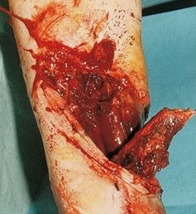
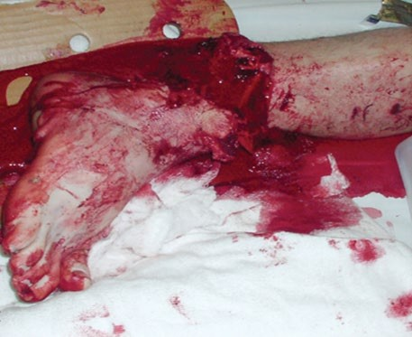
Module 19: Fractures
OPEN FRACTURES (Cont.)
Important Considerations with OPEN FRACTURES:
Open wound(s) – associate with an overlying skin wound, significant risk of infection (osteomyelitis)
Open fractures may not always be always be to identify in a trauma patient
Wound(s) near a possible fracture is considered an open fracture and should be treated as such
Protruding bone of bone end should not be replaced
Bones occasionally return to a near-normal position when realigned
Treat all fractures with nearby skin wounds as open fractures
P A W
S
#TCCC-CPP-PPT-19 08 AUG 23
8

Slide 9

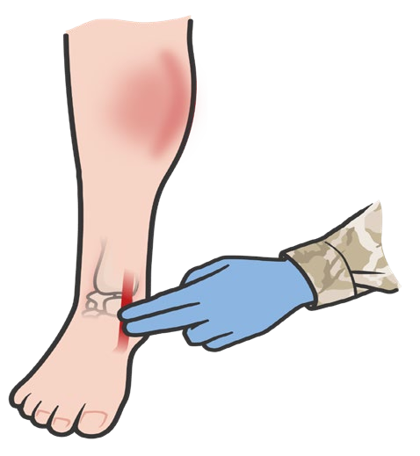

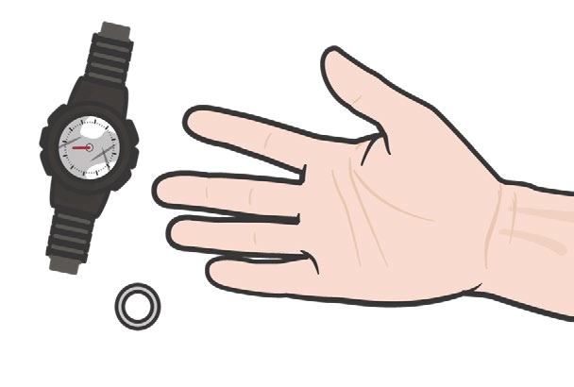

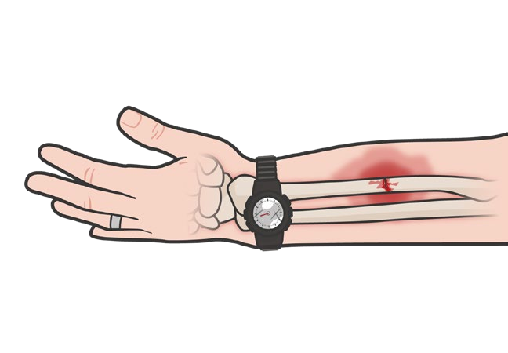

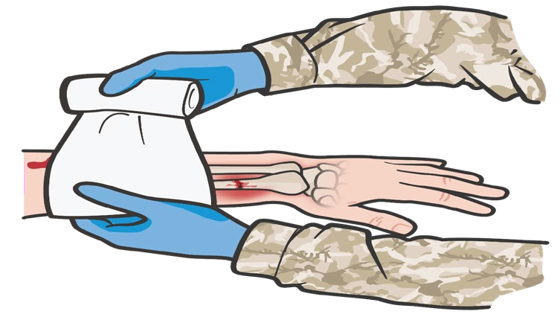

Module 19: Fractures
BASIC MANAGEMENT OF FRACTURES
PRIMARY OBJECTIVES
of Fracture Treatment:
Identify the location of the fracture and place the extremity in a NEUTRAL POSITION or POSITION of FUNCTION.
REMOVE watches, rings, bracelets or potential constricting materials
Prevent further injury Protect nerves
and vessels
Make the casualty more comfortable (pain relief)
CHECK PULSES, skin
color, and sensorimotor function distal to the site of the fracture
DRESS ALL WOUNDS prior
to splint application
REASSESS BLEEDING
control prior to further management of the fracture
P A W
S
Level of Evidence: C-LD
#TCCC-CPP-PPT-19 08 AUG 23
9
Notes:
The primary objectives of fracture management and splinting are to prevent further injury to local tissues or organs, protect the nerves and vessels that run parallel to bones, and make the casualty more comfortable by relieving their pain.⁸
Hemorrhage control in open fractures should have already been addressed as part of your tactical trauma assessment and treatments prior to this point, but should be reassessed prior to any further management of the fracture; and control should be reestablished, if necessary. Direct pressure and pressure bandages usually control bleeding unless an artery has been lacerated.⁹
Pulses, skin color, and sensorimotor function distal to the fracture site should be assessed, looking for any changes compared to the unaffected side. Even a seemingly minor fracture has the potential to compromise the vascular or nerve structures that run alongside the bones or may cause a compartment syndrome, and compromises to the neurovascular status of the extremity impact the urgency of the evacuation request in order to save the limb.¹⁰ Also, splinting has the potential for compromising the casualty’s distal neurovascular status, and a baseline assessment needs to be performed to compare with a post-application assessment.
It is common for an injured extremity to swell distal to the fracture, so any watches, rings, bracelets, or potential constricting materials should be removed and secured.¹¹
When dealing with an open fracture, the wound should be dressed prior to splint application. If sterile or clean water is available and if the tactical situation permits, the injury can be irrigated to remove foreign bodies that may be a source of infection and even bone fragments that might cause further tissue damage.¹² But often that is not an option in the TFC phase and the wound can be dressed as is, once the bleeding is controlled. Time and resources permitting, wound debridement can also be considered.¹³
In some cases, injuries unrelated to the fracture may be hidden once a splint is applied; so, ensure that all wounds and injuries that might be covered by the splinting process are treated and documented prior to splint application.
The level of evidence supporting the guidance for basic principles of fracture management is based on a meta-analysis of observational studies, lab evaluations, and case studies.

Slide 10

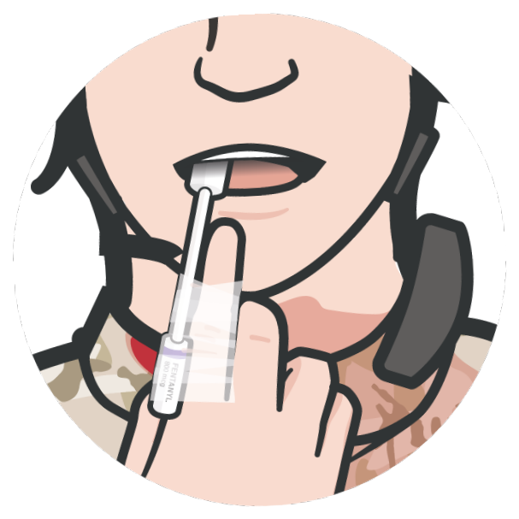

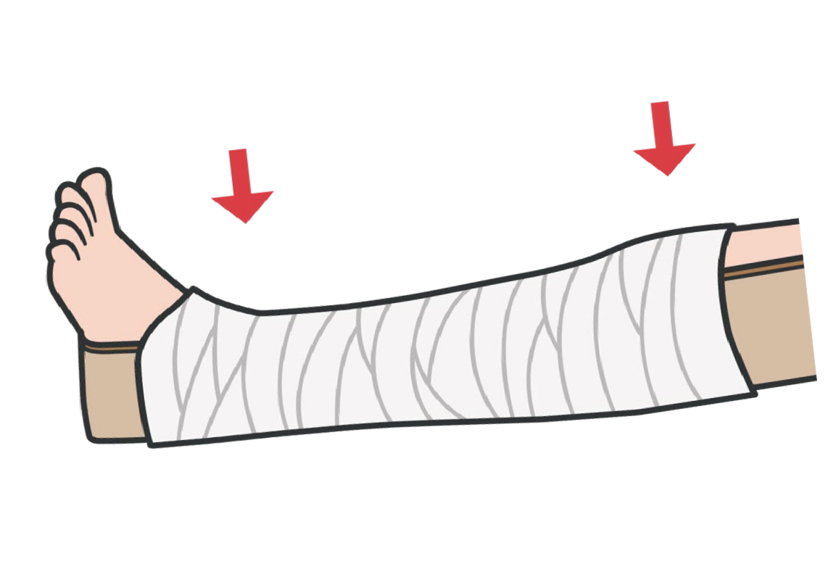


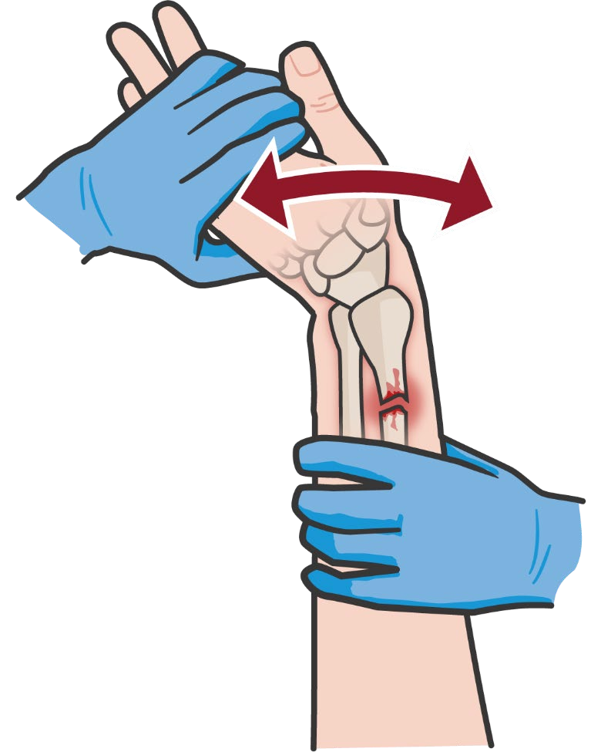
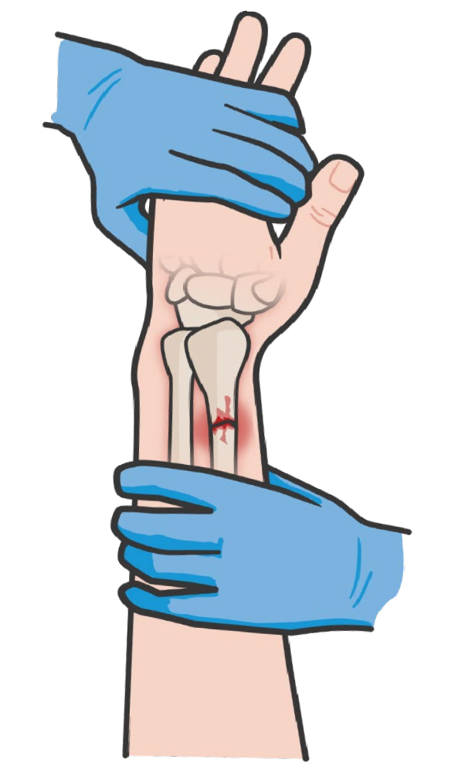
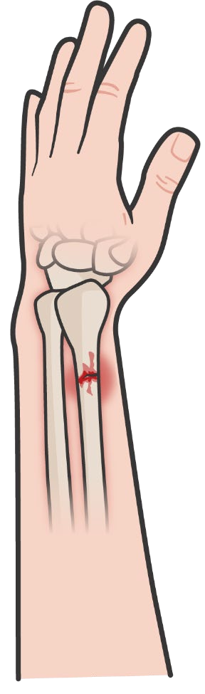

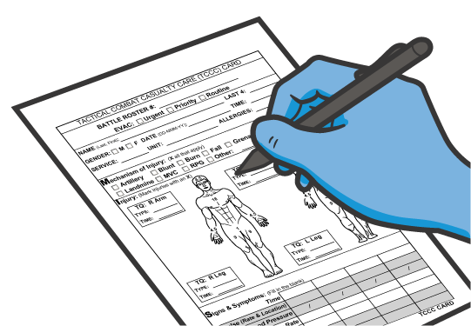

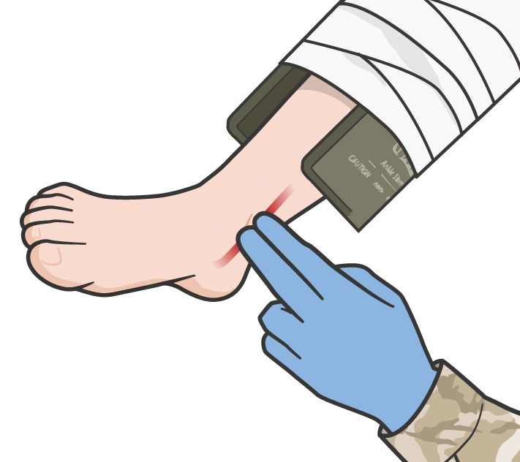
Module 19: Fractures
PRINCIPLES OF FRACTURE MANAGEMENT
Prior to splinting, an injured extremity should be returned to a normal anatomic position, if feasible
Always incorporate the joint proximal and the joint distal to the site of the fracture in your splint
ADMINISTER
pain medications and antibiotics, as appropriate
Once you have applied a splint, be sure to reassess the pulses, motor and sensory (PMS) function
Gentle manual traction
Realign bones
Reduced
DOCUMENT all findings and treatments on a DD Form 1380 TCCC Casualty Card
Exercise caution during
fracture reduction
and attach it to the casualty
P A W
S
#TCCC-CPP-PPT-19 08 AUG 23
10
Notes:
The primary objectives of fracture management and splinting are to prevent further injury to local tissues or organs, to protect the nerves and vessels that run parallel to bones, and to make the casualty more comfortable by relieving their pain.
Prior to splinting, an injured extremity should be returned to a normal anatomic position, if feasible.¹⁴ This may involve the gentle use of manual traction to realign the bones to their baseline anatomical position, but care must be exercised when attempting a reduction. If a second attempt to reduce has been unsuccessful, the fracture should be splinted as is in order to minimize any excess manipulation. When attempting to reduce a fractured extremity, with no distal pulse the goal of the reduction is to restore pulse to the limb. Once reduced, the restored alignment can alleviate compression and result in increased perfusion and decreased pain.
Remember, one of the primary objectives of splinting is to prevent movement of the injured body part; so be sure to splint your casualty prior to moving them whenever you can, as that is the most common time for a fracture to be compromised.
Always incorporate the joint proximal and the joint distal to the site of the fracture in your splint.¹⁵ There are rare times when this cannot be done, but every effort should be made to immobilize both joints, as movement at either joint will result in movement at the fracture site, resulting in both increased pain and possible further injury.
Once you have applied a splint, be sure to reassess the pulses, motor, and sensory (PMS) function distal to the fracture, and compare that to the baseline PMS assessment you performed prior to splint application.¹⁶ If there is a decline in function, then the splint needs to be removed and reapplied, ensuring that it did not place the limb in a non-anatomic position or that the securing bandages were not applied too tightly.
Although realignment of the fracture and splinting can result in decreased pain, it is still appropriate to administer pain management based on the TCCC Guidelines. And antibiotic administration is indicated for any open fractures.¹⁷
Consider elevating the extremity to reduce edema and decrease pain, if tactically feasible.¹⁸ This is not always possible, particularly during casualty transport. Also, take care to avoid having the littler straps apply direct pressure on a fracture site whenever possible, as this will both create additional pain and potentially cause further injury.

Slide 11

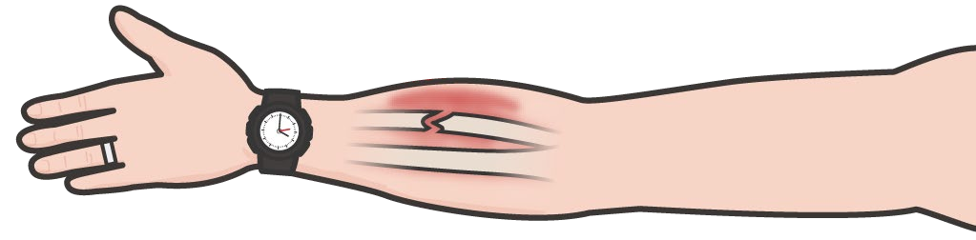
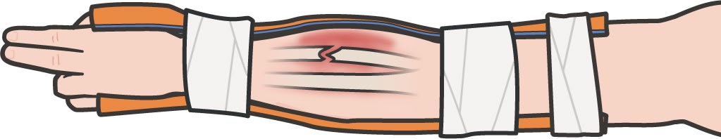


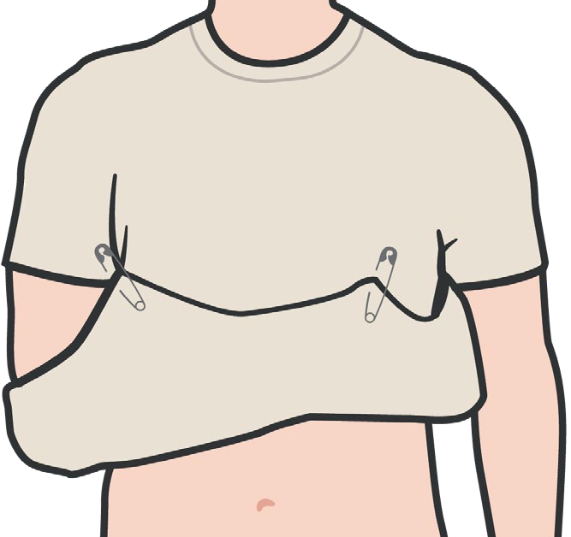
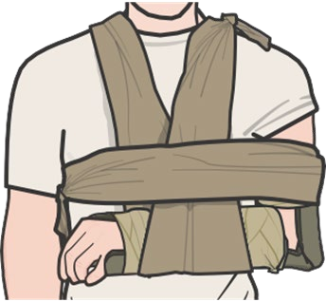
Module 19: Fractures
BASIC SPLINTING PRINCIPLES
Collect materials for splints, padding and securing the splint prior to getting started
Have a CLS or CMC assist you, when possible
Use the unaffected extremity to mold or design your splint
Incorporate one joint above and one below the fracture
Pad all voids to prevent the splint from applying direct pressure to the injured site
Secure splint with elastic bandage, cravats, tape, etc.
Consider slings and/or swathes, including using the casualty’s shirt or sleeve, if appropriate
Check skin color and PMS before and after splinting
P A W
S
Notes:
Begin by collecting all of the potential splinting materials you will need prior to starting. Once you begin the process of applying a splint, it is difficult to leave and gather additional materials without having to start over again. The actual splinting materials can be malleable (formable to the contours of the site of the fracture) or rigid; but the principles of splinting are the same for both malleable and rigid materials. Padding and materials to secure the splint once applied are also necessary.¹⁹
Whenever available, ask a Combat Lifesaver or Combat Medic/Corpsman to help you. They can support the injured extremity during splint application if the casualty is unable to do that themselves, and can assist in holding the splint in place while it is secured.
Before applying it to the injury, measure and/or shape the splinting materials on the opposite (hopefully uninjured) extremity, whenever you can. This reduces the amount of manipulation at the site of the injury. When designing the splint, be sure to leave access to allow for a PMS assessment after the splint is applied.
As mentioned previously, ideally you want to design the splint so that the injury maintains its normal anatomic position. And the splint should encompass the joints above and below the site of the fracture.
Padding is essential, both for casualty comfort and sometimes for proper alignment. Ensure that any voids are filled to prevent the splint from applying pressure directly on the extremity, in particular over areas that are already tender.
Secure the splint with cravats, pressure bandages, cloth strips, or any available tape. Enough pressure should be applied to maintain the splint in position, but avoid exerting excessive pressure when securing. Also, tuck any loose ends of materials so that they do not create problems during casualty transport.
Depending on the situation, you may also consider slings and/or swathes to help keep the extremity close to the body and avoid unnecessary movements. This could even include using the casualty’s shirt and safety pins as a makeshift sling.
And as mentioned before, be sure to recheck the casualty’s PMS distal to any splint you apply and adjust the splint accordingly if there is a change from baseline.

Slide 12

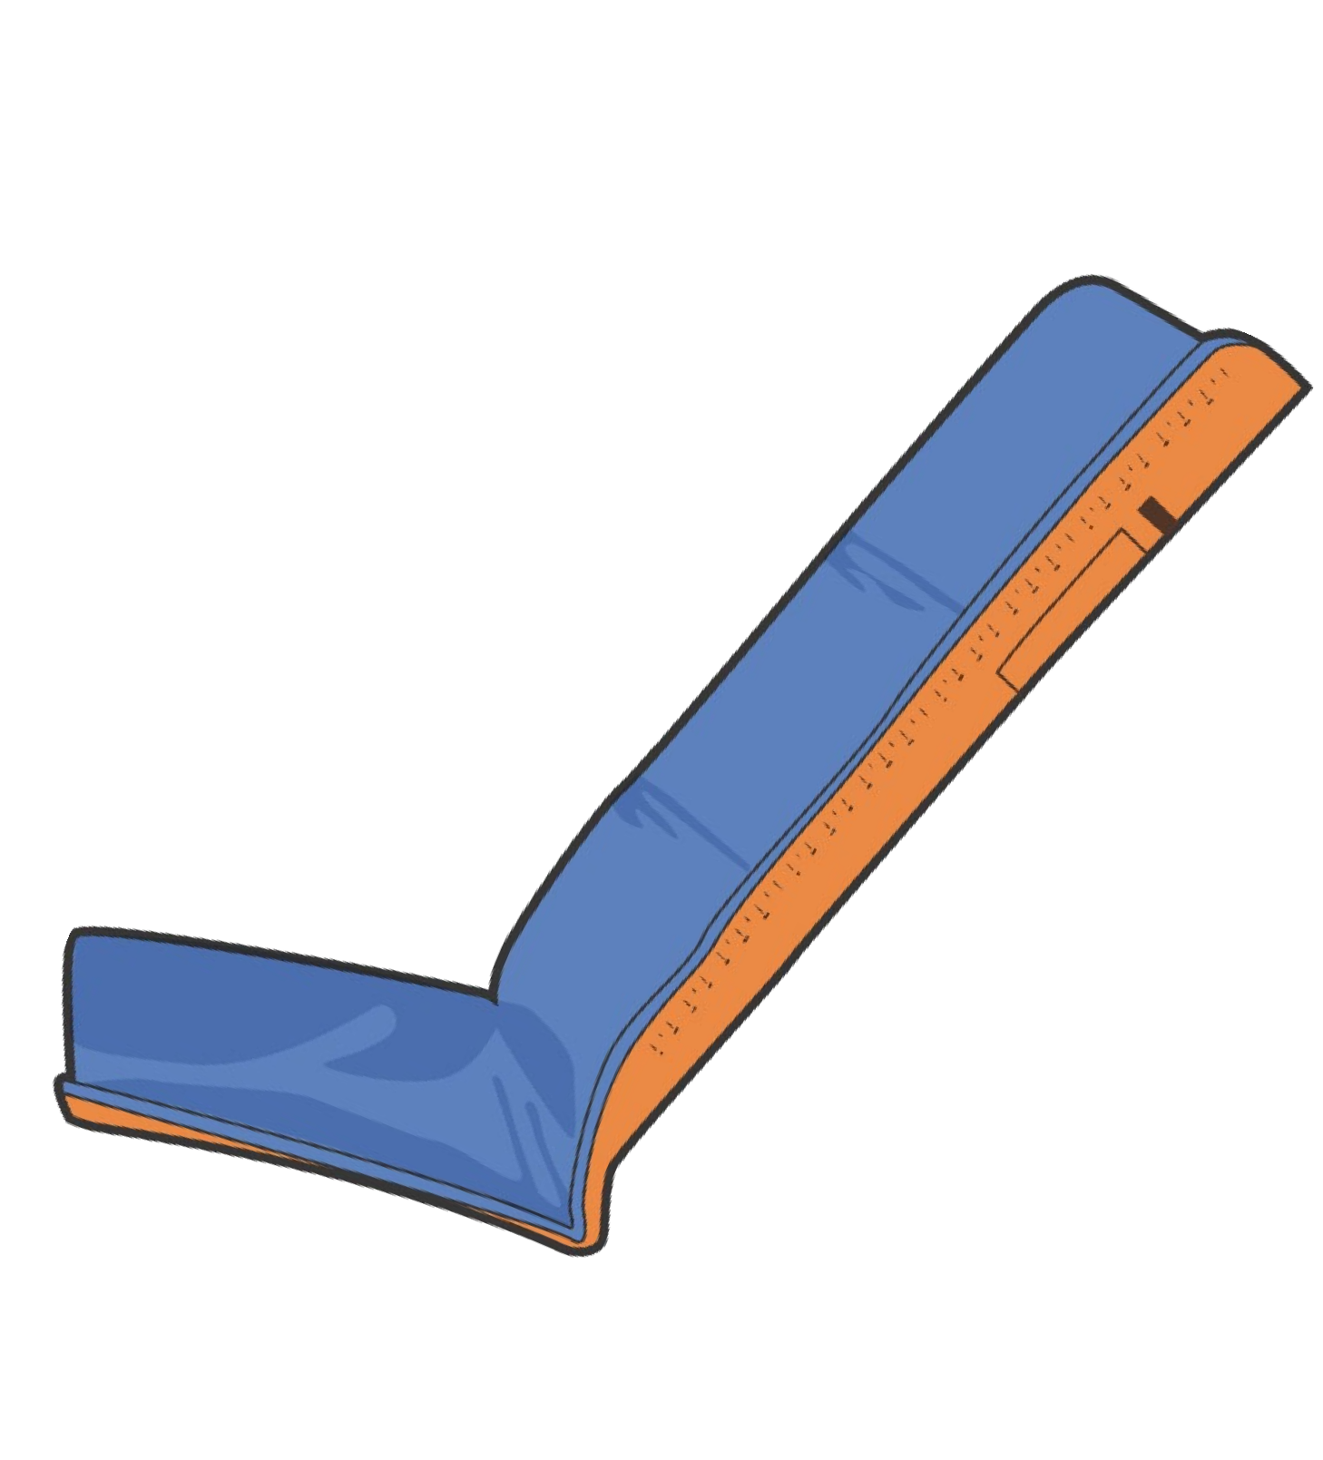


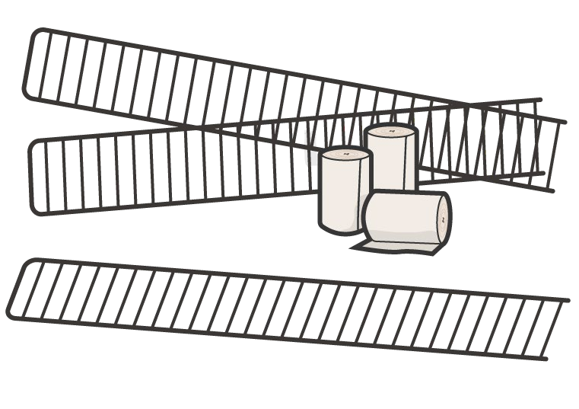
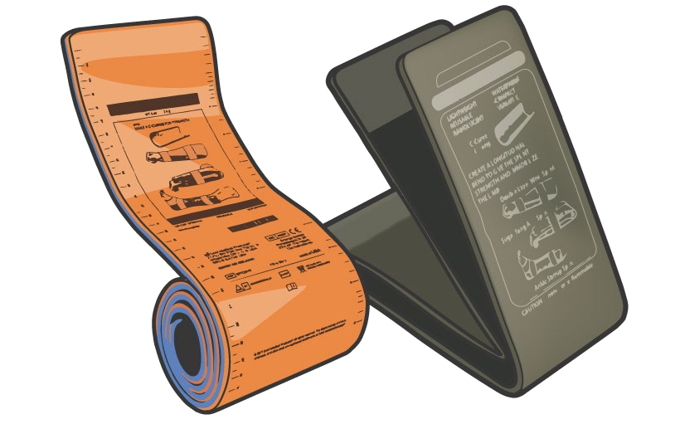
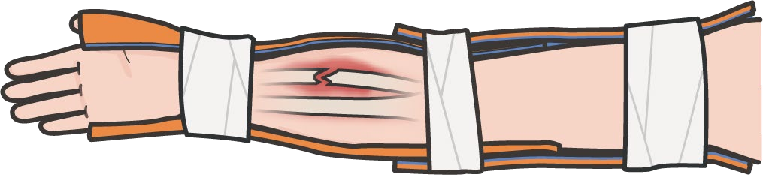
Module 19: Fractures
MALLEABLE SPLINTS
MALLEABLE SPLINTS gain rigidity by folding or creasing the metal framework
They can be contoured to the area of injury and molded around joints at angles
using casualty’s
unaffected limb
Good for shorter bones and angled splint positions; multiple malleable splints can be combined to support longer bone fractures
Foam-padded aluminum splints
Wire ladder splints
It is important to practice with the most common splints prior to deployment
P A W
S
Notes:
The two most common types of malleable splints are foam-padded aluminum/metal splints like the SAM® splint and wire ladder splints. These splints gain rigidity by folding or creasing the metal framework, so they have to be molded and bent to stabilize the bone. Simply wrapping them around the area of injury or joints will not provide the support needed. Some evacuation assets also use vacuum splints that are molded around the fracture and become rigid when the air is removed.
One advantage that malleable splints have compared to rigid splints, is that they can be contoured to the area of injury and be molded around joints at angles. This not only provides the rigidity they need to support the fracture, but minimizes the need for excess packing and often provides more comfort for the casualty. That said, malleable splints still need to be properly padded with other materials, despite foam padding on their surface.
There are many shapes and uses for malleable splints, and it is important to practice with the most common splints prior to deployment, using the same materials you will potentially have access to when downrange.
In general, malleable splints are good for shorter bones and angled splint positions, as the additional creases and bends lead to increased rigidity when compared to a straight, long splint. That said, multiple malleable splints can be combined and secured in ways that support longer bone fractures, as well.

Slide 13
Module 19: Fractures
MALLEABLE SPLINTING VIDEO
Video can be found on deployedmedicine.com
Notes:
The following video will highlight some of the splinting principles using malleable splints that we’ve just discussed.

Slide 14


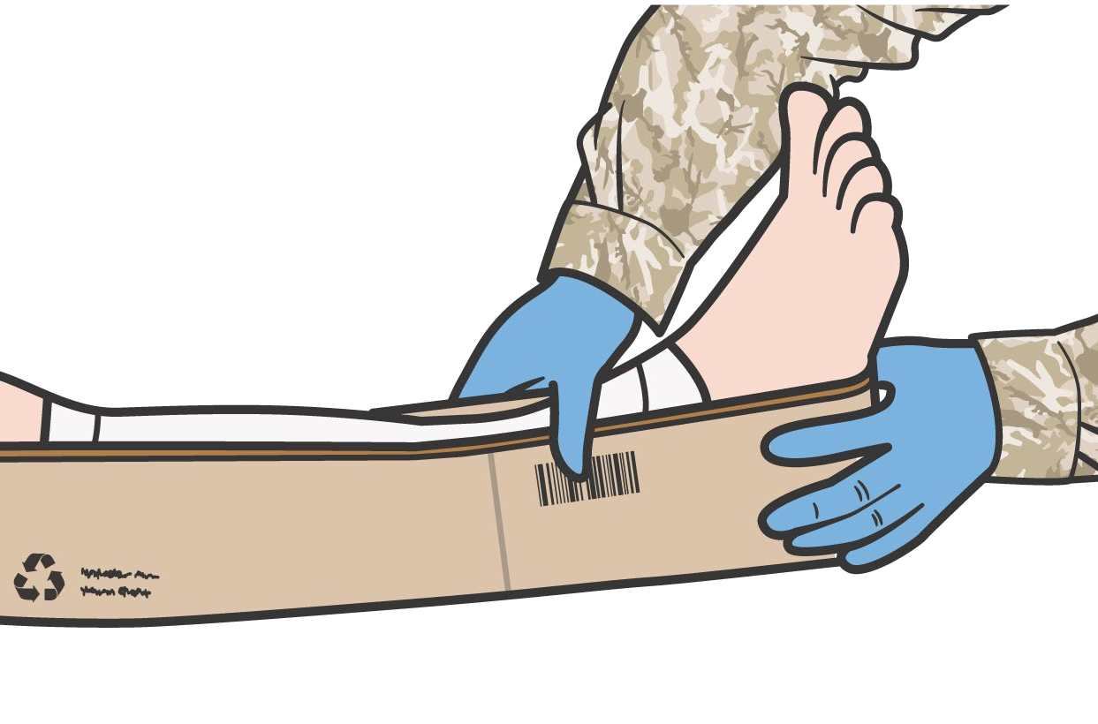
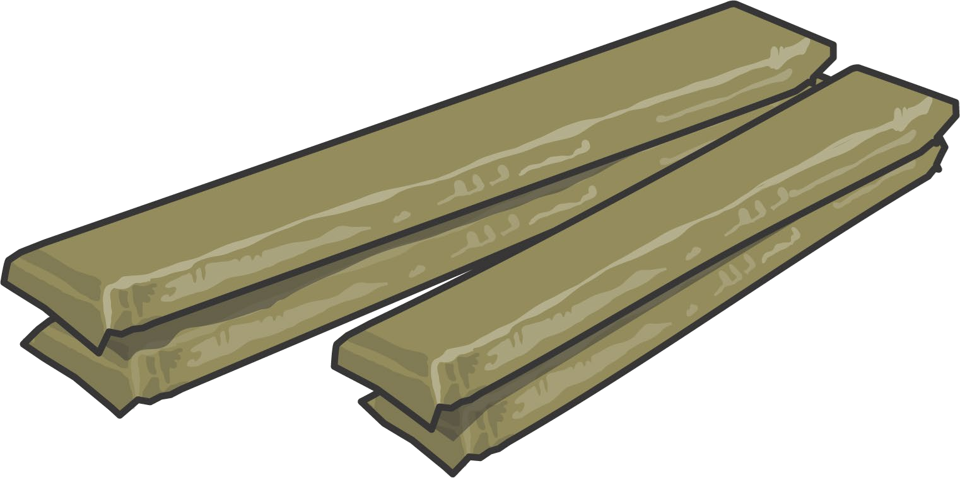

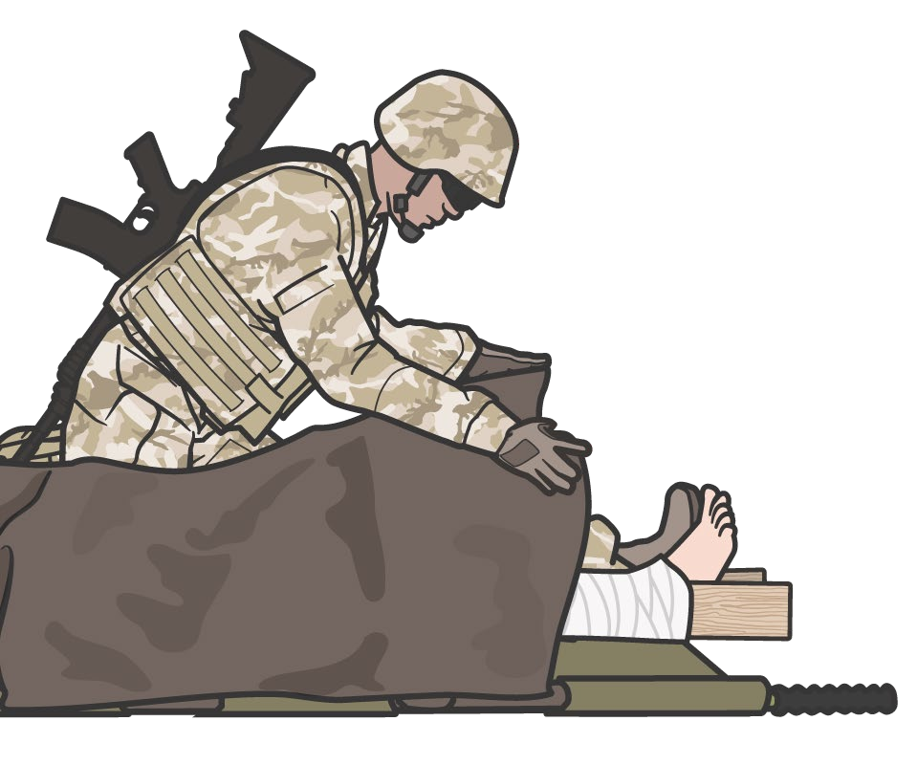

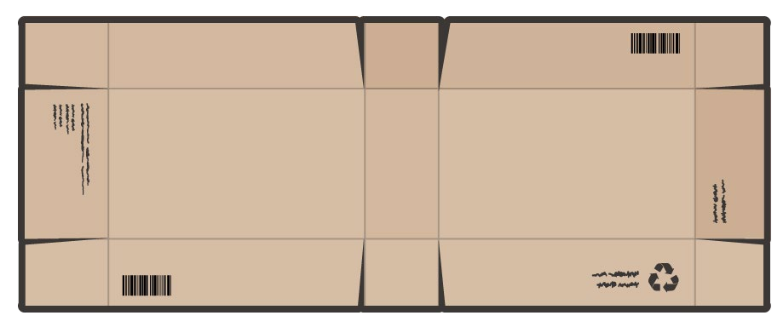

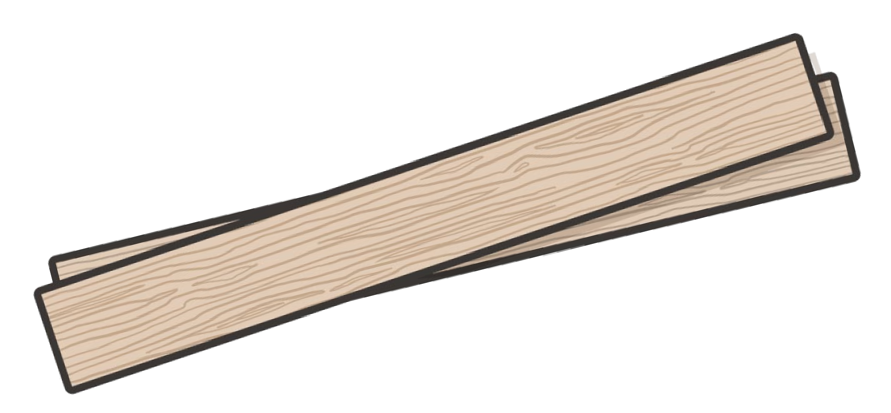
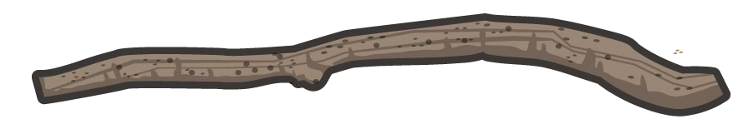
RIGID SPLINTS
Module 19: Fractures
The lack of anatomic contours will usually require more padding
Padded board splints
Often the ends of the splints stick out, creating a hazard during casualty transport
Improvised rigid splint materials
P A W
S
Notes:
Several different types of materials can serve as rigid splints. Some of these are materials dedicated to splinting, but often the tactical situation lends itself to improvisation.
It is less common to see rigid splints in current aid bags or on transport vehicles. These padded boards take up more room and are less versatile than malleable splints. Depending on the unit mission and operating procedures, you may encounter traction splints. They are a type of rigid splint that applies traction to the extremity while stabilizing the long bones, and are commonly used on femur fractures where the large muscles can make restoring the normal anatomic position of the fracture problematic.²⁰
More commonly, you will find yourself using something from the environment as a rigid splint. This could be a sturdy tree limb, a piece of wood, a metal or wooden pole, folded cardboard, or even the casualty’s weapon, ensuring that it is unloaded and safe. The length of the objects may be pre-determined and create application problems, depending on the site being splinted.
Another issue to remember with rigid splints is that the lack of anatomic contours means that more padding will usually be needed, so be sure to gather adequate padding materials prior to application.
Rigid splints are often good for long bones (like you see in leg fractures) because of the strength of the materials used. But it is very common for the ends of the splints to protrude beyond the extremity itself, creating a potential hazard during casualty transport, and care should be taken to minimize this, whenever possible.

Slide 15
Module 19: Fractures
RIGID SPLINTING VIDEO
Video can be found on deployedmedicine.com
Notes:
The following video will highlight some of the splinting principles using rigid splints that we’ve just discussed.

Slide 16

THINGS TO AVOID WHEN SPLINTING
Module 19: Fractures
Manipulating the fracture site too much; resulting in pain, additional damage to tissues, blood vessels and nerves
Splinting near or over a wound that has not be properly treated
Failing to immobilize joint above and below fracture when possible
Securing too tightly, cutting off blood flow
Failing to pad properly, making casualty uncomfortable during transport/evacuation
P A W
S
Notes:
There are a handful of common errors made when applying splints, including:
Manipulating the fracture site too much; resulting in pain, additional damage to tissues, blood vessels, and nerves
Splinting near or over a wound that has not been properly treated
Failing to immobilize joint above and below fracture when possible
Securing the splint too tightly, cutting off blood flow
Failing to pad properly, making the casualty uncomfortable during transport/evacuation
Taking care to follow the recommended steps in the splinting skill instructions will help avoid these errors.

Slide 17

Module 19: Fractures
EVIDENCE SUPPORTING FRACTURE GUIDANCE
Subject Category | Study Types | Level of Evidence
Basic Management and Principles of Fracture | Meta-analysis of observational studies, lab evaluations and case studies | C-LD
Notes:
Most of the evidence supporting the TCCC Guidelines and recommended approaches to fracture management is not based on clinical studies, per se, but on decades of best practices that were refined based on both retrospective and observational reviews and studies of the clinical outcomes of casualties who were treated for their fractures. So, although there may not be a series of recent prospective, randomized trials looking at different management protocols, the historical evidence for maintaining established practices is clear, and professional societies outside of the military mirror the guidance found in the military clinical practice guidelines and operating procedures.
Specifically, as it relates to this module’s learning objectives, there is a moderate to high level of evidence supporting the signs that identify a potential fracture, the basic fracture management principles, and the splint application steps that are recommended in the skill instructions. These are found in all of the main textbooks on fractures and splinting, and referenced in many of the large review articles on combat-related fractures.
The evidence for the use of antibiotics in open fractures was previously mentioned in the module on antibiotics, where there is moderate evidence, based on randomized trials, that administering antibiotics in the TFC phase will have a positive outcome on infection prevention or treatment for all wounds, to include open fractures.^{21, 22}

Slide 18

Module 19: Fractures
ASSESSING THE EVIDENCE FOR GUIDELINES
Level of Evidence | AHA Recommendation System Terminology Explanation | Why the AHA Classification System?
A | Evidence from multiple randomized clinical trials (RCT) with concordant results or from HIGH-QUALITY meta-analyses. | The level of evidence recommendations allow readers to quickly glean information on the strength, certainty, and quality of evidence supporting each recommendation. A recommendation with Level of Evidence (LOE) C does not imply that the recommendation is weak. Although, RCTs are unavailable, there may be a very clear clinical consensus that a particular test or therapy is useful or effective.
B-R | Evidence from moderate-quality trials, or a meta-analysis of moderate quality (RCT) followed by an R to denote RANDOMIZED studies
B-NR | Evidence from moderate-quality trials, or a meta-analysis of moderate quality followed by NR to denote NON-RANDOMIZED studies
C-LD | There is no convincing evidence and is followed by LD to indicate LIMITED DATA
C-EO | There is no convincing evidence and is followed by EO if the consensus is based on EXPERT OPINION, case studies or standards of care.
Notes:
Evidence-based recommendations and guidance are the result of a careful review of studies and discussion by a panel of subject matter experts. For TCCC, the subject matter expert panels include both Committee on TCCC members and select invited subject matter experts from within both the military and civilian community, based on the specific interest area.
Why the AHA Classification System?
The level of evidence classification combines an objective description of the existence and the types of studies supporting the recommendation and expert consensus, according to 1 of the following 3 categories:²⁹
Level of evidence A: recommendation based on evidence from multiple randomized trials or meta-analyses
Level of evidence B: recommendation based on evidence from a single randomized trial or nonrandomized studies
Level of evidence C: recommendation based on expert opinion, case studies, or standards of care.
The level of evidence recommendations allows readers to quickly glean information on the strength, certainty, and quality of evidence supporting each recommendation. The Level of Evidence (LOE) denotes the confidence in or certainty of the evidence supporting the recommendation, based on the type, size, quality, and consistency of pertinent research findings.³⁰
A recommendation with level of evidence C does not imply that the recommendation is weak. Many important clinical questions addressed in guidelines do not lend themselves to clinical trials. Although, Randomized Clinical Trials are unavailable, there may be a very clear clinical consensus that a particular test or therapy is useful or effective.

Slide 19

SKILL STATION
Module 19: Fractures
Splint Application
Splint application using Malleable, Rigid, and/or Improvised splinting materials

Slide 20
SUMMARY
Module 19: Fractures
Knowledge Topics
Identifying the signs and symptoms of fractures
Distinguishing open from closed fractures The basic management of fractures
Evidence supporting the strategies for fracture management and splinting in TFC
Skills and Abilities
Malleable, Rigid, and/or Improvised Splint application
Notes:
This module reviewed the basic principles of splinting in the Tactical Field Care phase.
We discussed identifying fractures and classifying them as open or closed. We also reviewed the basic management of fractures, to include application of splints.
Afterward, you demonstrated splint application using both malleable and rigid splints in the skill stations.
Remember, the primary objectives of fracture management and splinting are to prevent further injury to local tissues or organs, to protect the nerves and vessels that run parallel to bones, and to make the casualty more comfortable by relieving their pain.
The most important aspects of splinting are to prevent further injury, splint in a way that does not harm the nerves or blood vessels in the splinted extremity, and minimize the casualty’s pain.

Slide 21

CHECK ON LEARNING
Module 19: Fractures
What are the three objectives of fracture management and splinting?
TRUE or FALSE: When applying a splint, ensure the joints above and below the fracture are immobilized in the splint whenever possible?
What should you assess before and after splinting?
Notes:
To close out this module, check your learning with the questions below (answers under the image).
Answers
What are the three objectives of fracture management and splinting?
The primary objectives of fracture management and splinting are to prevent further injury to local tissues or organs, to protect the nerves and vessels that run parallel to bones, and to make the casualty more comfortable by relieving their pain.
True or False: When applying a splint, ensure the joints above and below the fracture are immobilized in the splint whenever possible.
True. Always incorporate the joint proximal and the joint distal to the site of the fracture in your splint.
What should you assess before and after splinting?
Pulses, skin color, and sensorimotor function distal to the site of the fracture should be assessed.
Once you have applied a splint, be sure to reassess the pulses, motor, and sensory (PMS) function distal to the fracture, and compare that to the baseline PMS assessment you performed prior to splint application.

Slide 22




Module 19: Fractures
ANY QUESTIONS?

Slide 23

REFERENCES
Module 19: Fractures
TCCC: Guidelines
by JTS/CoTCCC
These guidelines, updated regularly, are the result of decisions made by CoTCCC in exploring evidence-based research on best practices.
PHTLS: Military Edition, Chapter 25
by NAEMT
Prehospital Trauma Life Support (PHTLS), Military Edition, teaches and reinforces the principles of rapidly assessing a trauma patient using an orderly approach.
Notes:
¹ Osier, C, et al. Orthopedic Trauma: Extremity Fractures. Military Medicine. Vol. 183, September/October Supplement 2018, p. 105.
² Belmont PJ, McCriskin BJ, Hsiao MS, Burks R, Nelson KJ, Schoenfeld AJ. The nature and incidence of musculoskeletal combat wounds in Iraq and Afghanistan (2005-2009). J Orthop Trauma. 2013; 27(5): e107-e113.
³ Tactical Combat Casualty Care Guidelines, 15 December 2021, https://deployedmedicine.com/market/31/content/40, accessed 24 Dec 21.
⁴ Krompinger WJ, Fredrickson BE, Mino DE, Yuan HA. Conservative treatment of fractures of the thoracic and lumbar spine. Orthop Clin North Am 1986; 17:161-70.
⁵ National Association of Emergency Medical Technicians. Prehospital Trauma Life Support, 9th Edition (2020). Chapter 12, p. 405.
⁶ National Association of Emergency Medical Technicians. Prehospital Trauma Life Support, 9th Edition (2020). Chapter 12, p. 405.
⁷ https://jts.amedd.army.mil/assets/docs/cpgs/Infection_Prevention_in_Combat-related_Injuries_27_Jan_2021_ID24.pdf, accessed 24 Oct 21.
⁸ Camuso, M. (2006). Far-Forward Fracture Stabilization: External Fixation Versus Splinting. Journal of the American Academy of Orthopaedic Surgeons, 14 (10), S118-S123.
⁹ National Association of Emergency Medical Technicians. Prehospital Trauma Life Support, 9th Edition (2020). Chapter 12, p. 406.
¹⁰ https://jts.amedd.army.mil/assets/docs/cpgs/Orthopaedic_Trauma_Extremity_Fractures_26_Feb_2020_ID56.pdf, accessed 24 Oct 21.
¹¹ National Association of Emergency Medical Technicians. Prehospital Trauma Life Support, 9th Edition (2020). Chapter 12, p. 406.
¹² Osier, C, et al. Orthopedic Trauma: Extremity Fractures. Military Medicine. Vol. 183, September/October Supplement 2018, p. 105.
¹³ https://jts.amedd.army.mil/assets/docs/cpgs/Orthopaedic_Trauma_Extremity_Fractures_26_Feb_2020_ID56.pdf, accessed 24 Oct 21.
¹⁴ National Association of Emergency Medical Technicians. Prehospital Trauma Life Support, 9th Edition (2020). Chapter 12, p. 406.
¹⁵ https://jts.amedd.army.mil/assets/docs/cpgs/Orthopaedic_Trauma_Extremity_Fractures_26_Feb_2020_ID56.pdf, accessed 24 Oct 21.
¹⁶ National Association of Emergency Medical Technicians. Prehospital Trauma Life Support, 9th Edition (2020). Chapter 12, p. 406.
¹⁷ Osier, C, et al. Orthopedic Trauma: Extremity Fractures. Military Medicine. Vol. 183, September/October Supplement 2018, p. 105.
¹⁸ National Association of Emergency Medical Technicians. Prehospital Trauma Life Support, 9th Edition (2020). Chapter 12, p. 406.
¹⁹ Auerbach PS, Constance BB, Freer L. Field Guide to Wilderness Medicine, 5th Edition (2019). Chapter 18: Orthopedic Injuries Splints and Slings; pp 172-173.
²⁰ National Association of Emergency Medical Technicians. Prehospital Trauma Life Support, 9th Edition (2020). Chapter 12, p. 406.
²¹ Murray CK, Hsu JR, Solomkin JS, et al. Prevention and management of infections associated with combat-related extremity injuries. J Trauma. 2008 Mar;64(3 Suppl):S239-51.
²² Yun H, Murray C, Nelson K, Bosse M. Infection after orthopaedic trauma: prevention and treatment. J Orthop Trauma. 2016 Oct;30 Suppl 3:S21-S26.
²³ Lee C, Porter KM. Prehospital management of lower limb fractures. Emerg Med J. 2005 Sep;22(9):660-3 C-LD
²⁴ Owens, B. D. , Kragh, J. F. , Macaitis, J. , Svoboda, S. J. & Wenke, J. C. (2007). Characterization of Extremity Wounds in Operation Iraqi Freedom and Operation Enduring Freedom. Journal of Orthopaedic Trauma, 21 (4), 254-257 C-LD
²⁵ Perkins TJ. Fracture management. Effective prehospital splinting techniques. Emerg Med Serv. 2007 Apr;36(4):35-7, 39 C-LD
²⁶ Reister FA. Battle casualties and medical statistics: US Army experience in the Korean war. Washington, DC: Department of the Army, Office of the Surgeon General; 1973
²⁷ Reister FA. Medical statistics in World War II. Washington, DC: Department of the Army, Office of the Surgeon General; 1975. p. 21
²⁸ Zouris JM,Walker GJ, Dye J, et al. Wounding patterns of US Marines and Sailors during Operation Iraqi Freedom, major combat phase. Mil Med 2006;171: 246–52 B-NR
²⁹ Tricoci P, Allen JM, Kramer JM, Califf RM, Smith Jr SC. Scientific Evidence Underlying the ACC/AHA Clinical Practice Guidelines. American Medical Association. 2009 Feb; Vol 301, No. 8.
³⁰ Halparin, JL. Further Evolution of the ACC/AHA Clinical Practice Guideline Recommendation Classification System. American College of Cardiology Foundation and the American Heart Association. 2016 Apr; 133:1426-1428.

